Slide 1
자바기본프로그래밍 8강
Kopo30 이동현

Slide 2
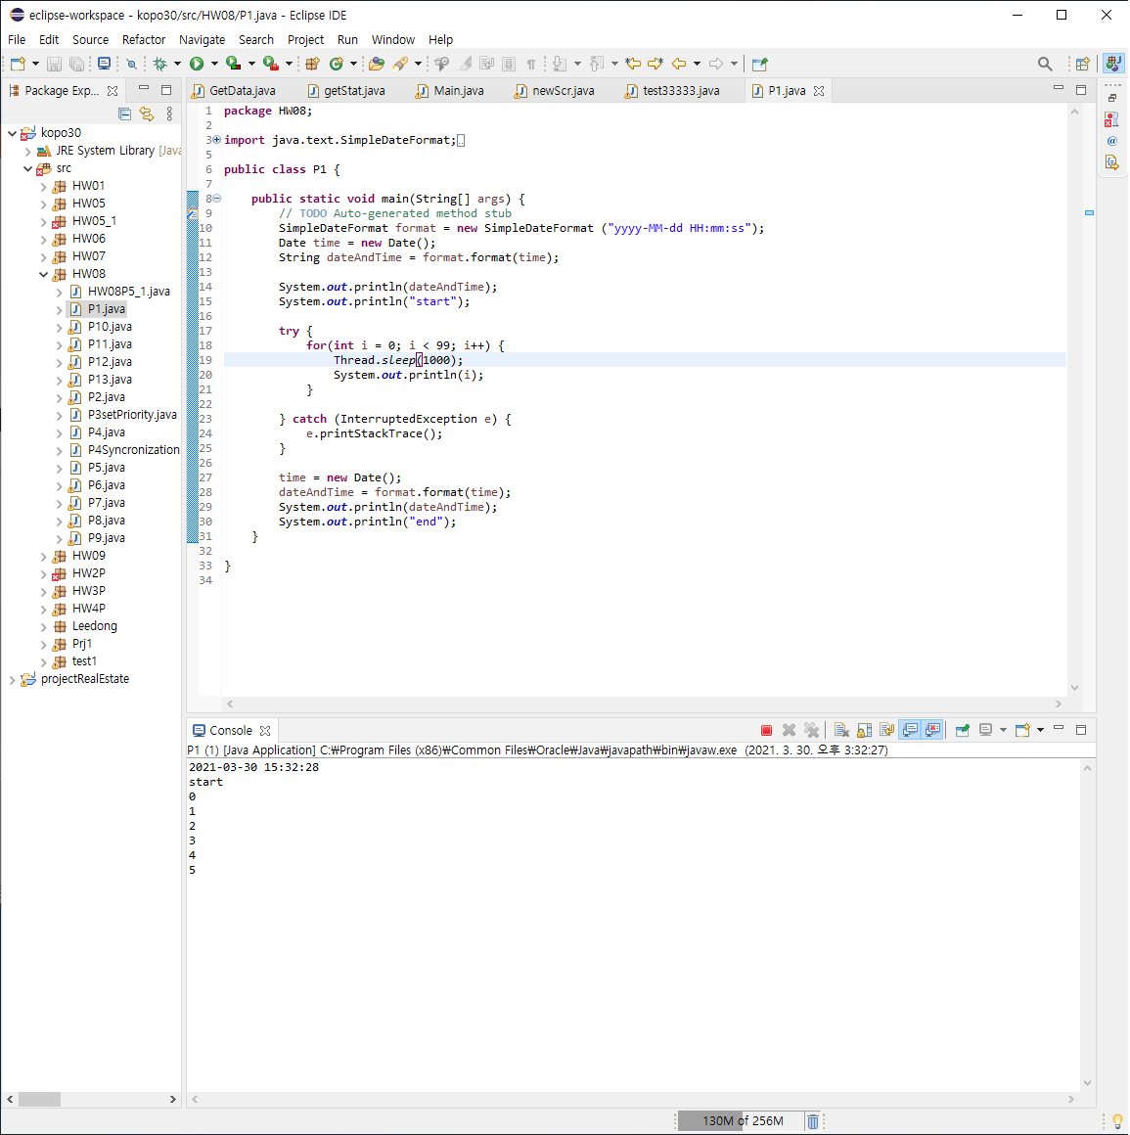
P1 : Print a number from 1 to 100 every second

Slide 3
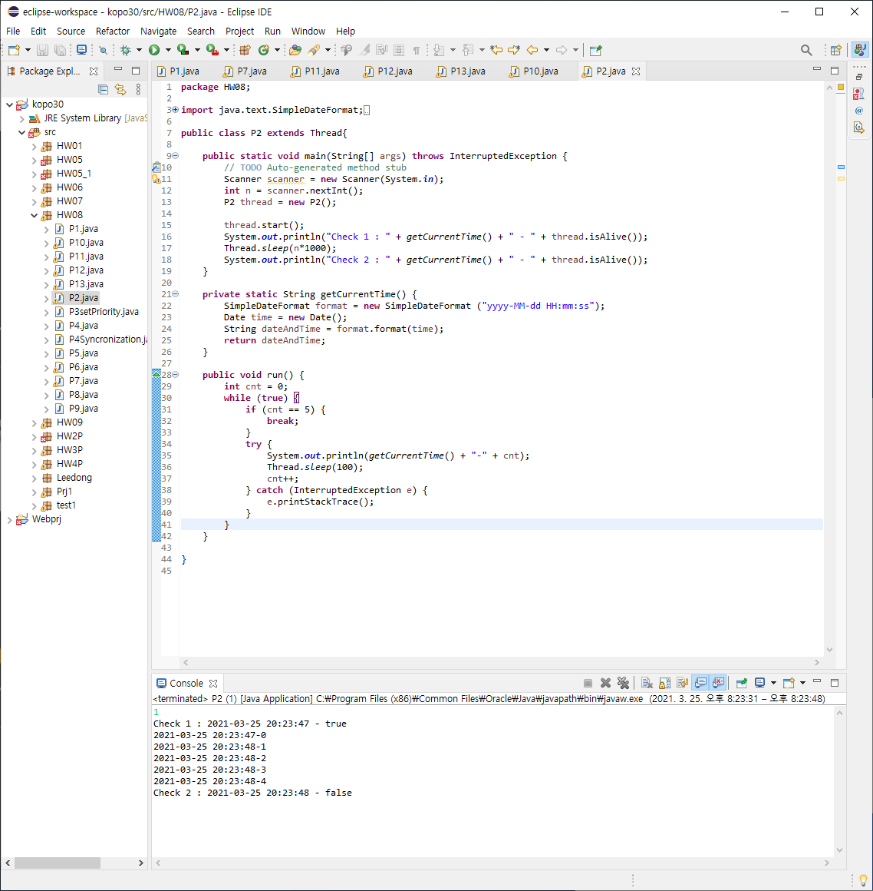
P2 : A thread is naturally destroyed

Slide 4
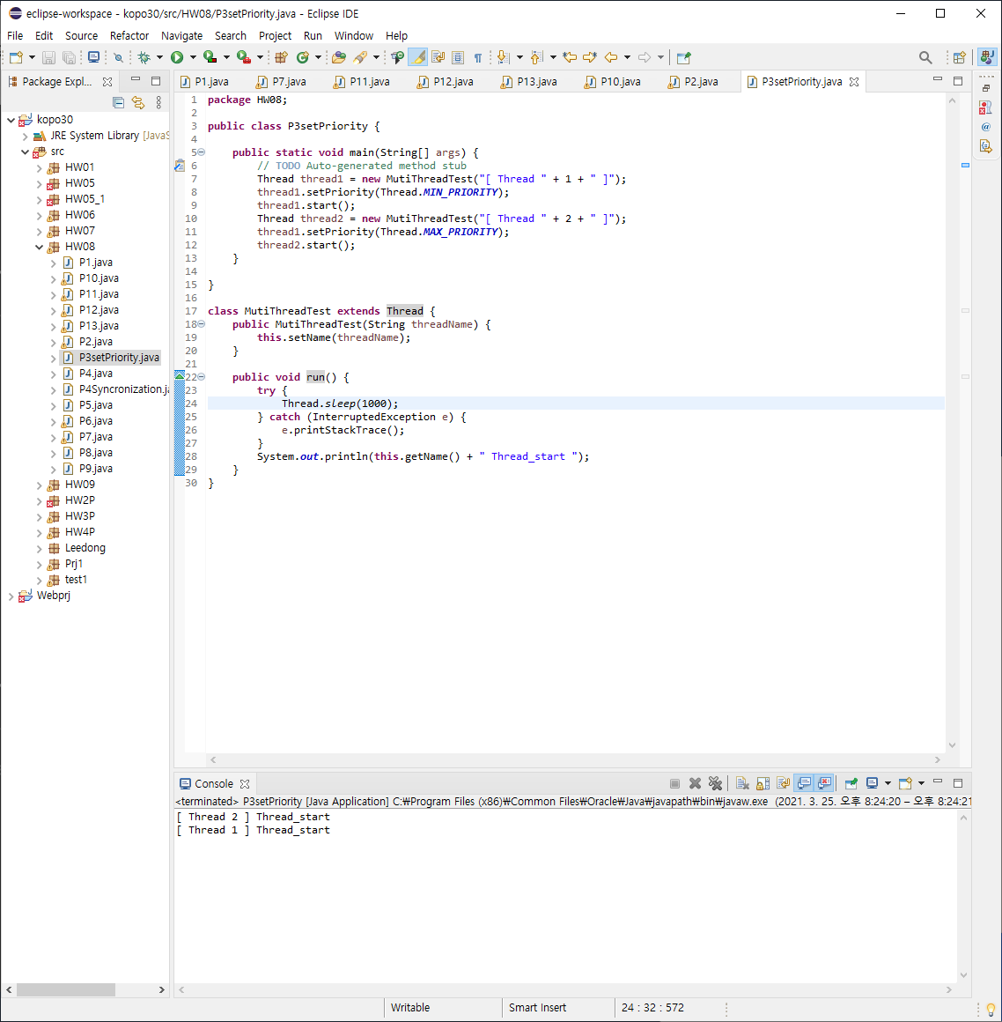
P3 : Change the parameter of “setPriority()”

Slide 5
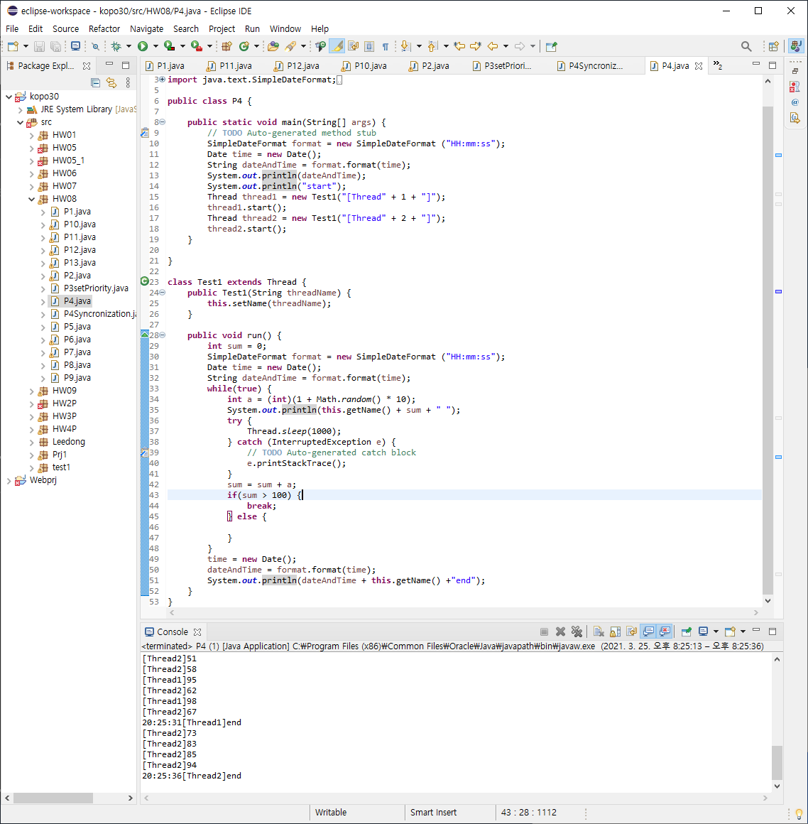
P4 : Find out and execute an example of “synchronized”

Slide 6
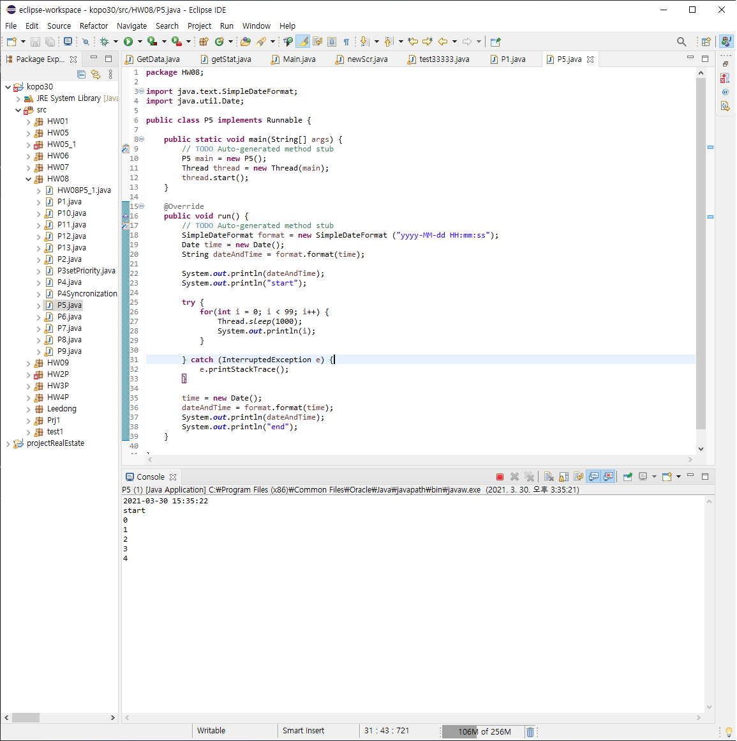
P5 : Implement the same program as P1

Slide 7
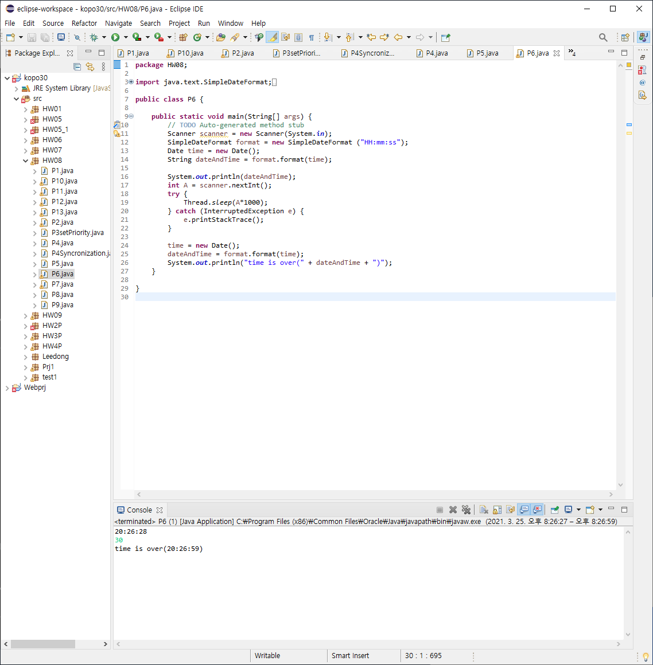
P6 : Timer

Slide 8
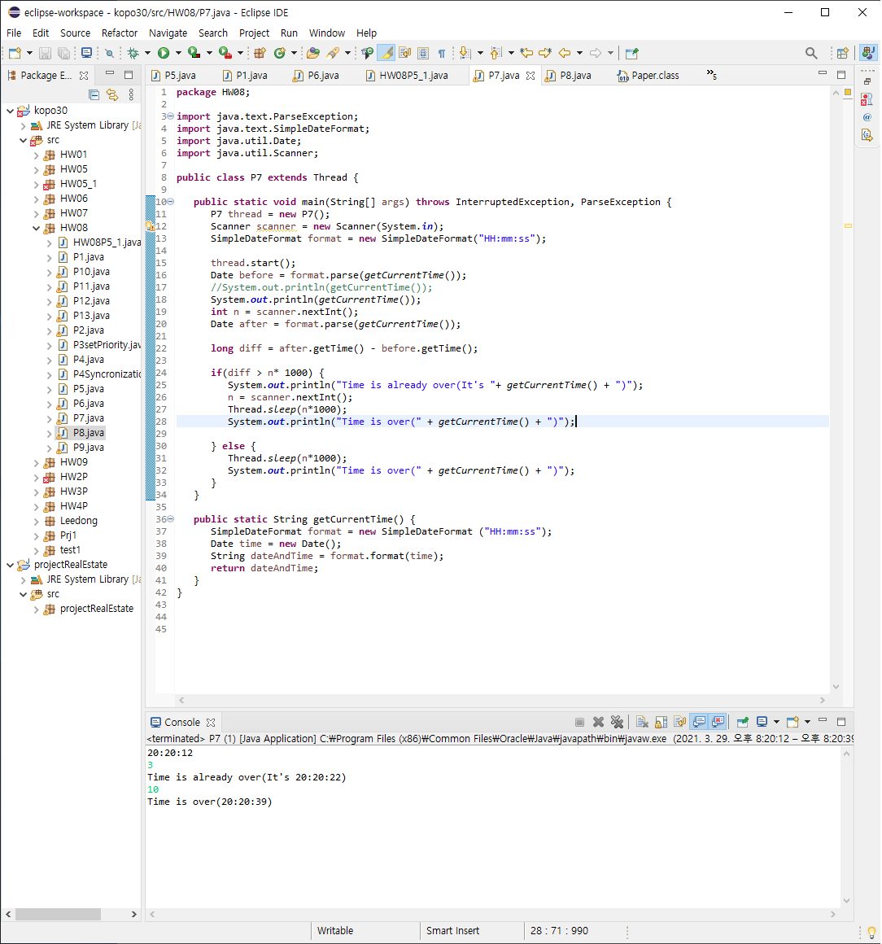
P7 : Timer 2

Slide 9
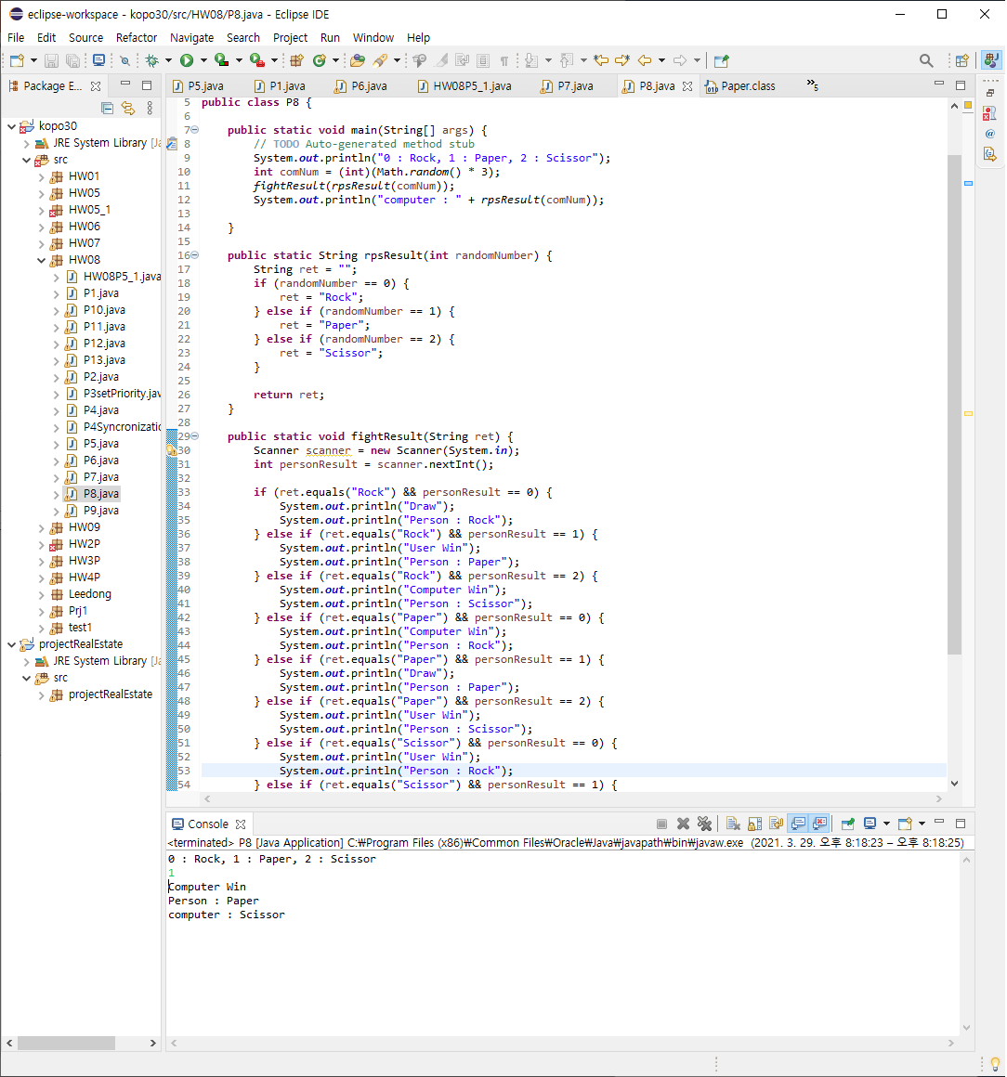
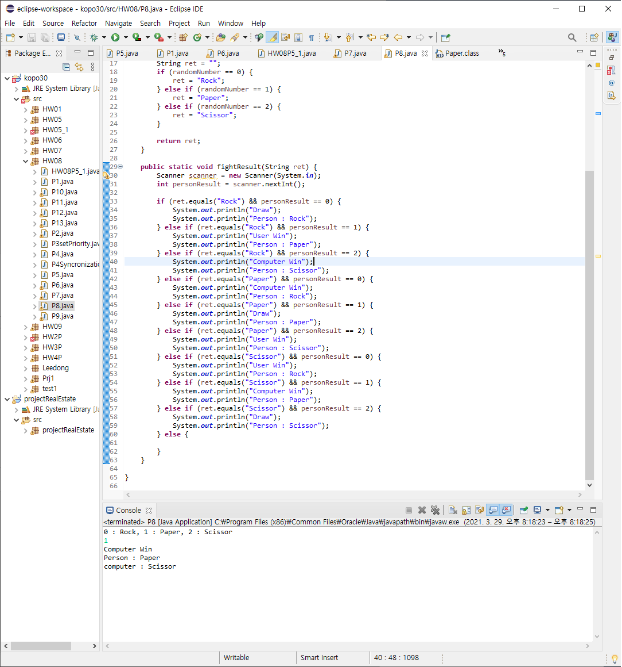
P8 : Rock-Paper-Scissors Game

Slide 10
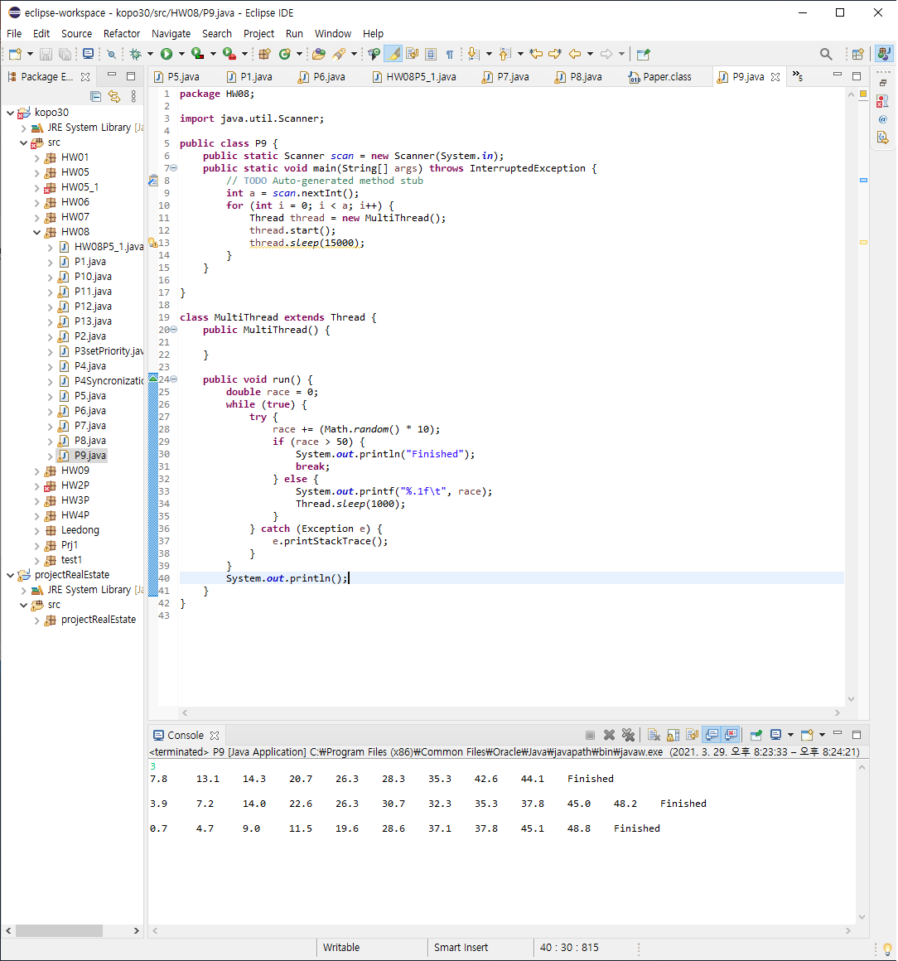
P9 : Running Race Game

Slide 11
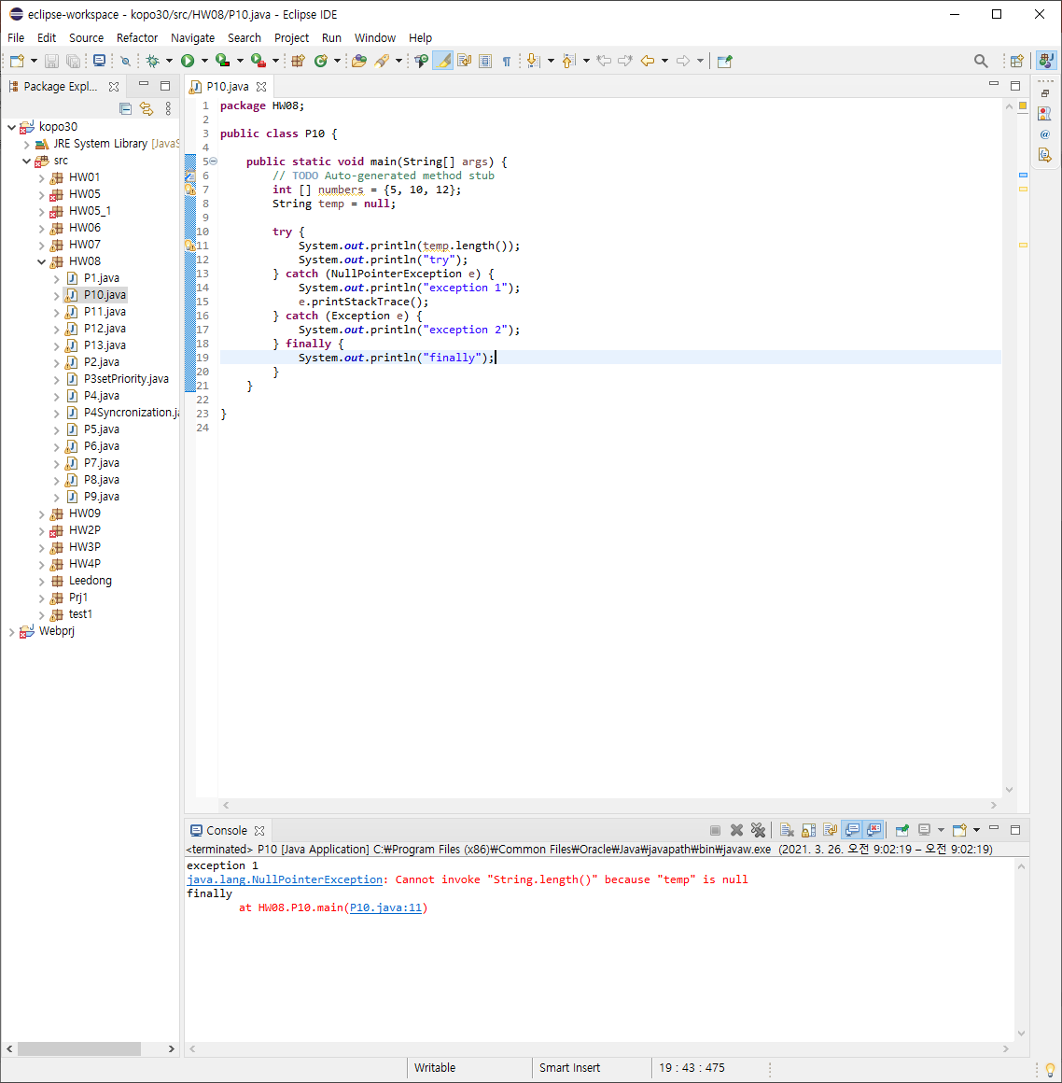
P10 : According to the error logs, change the error type

Slide 12
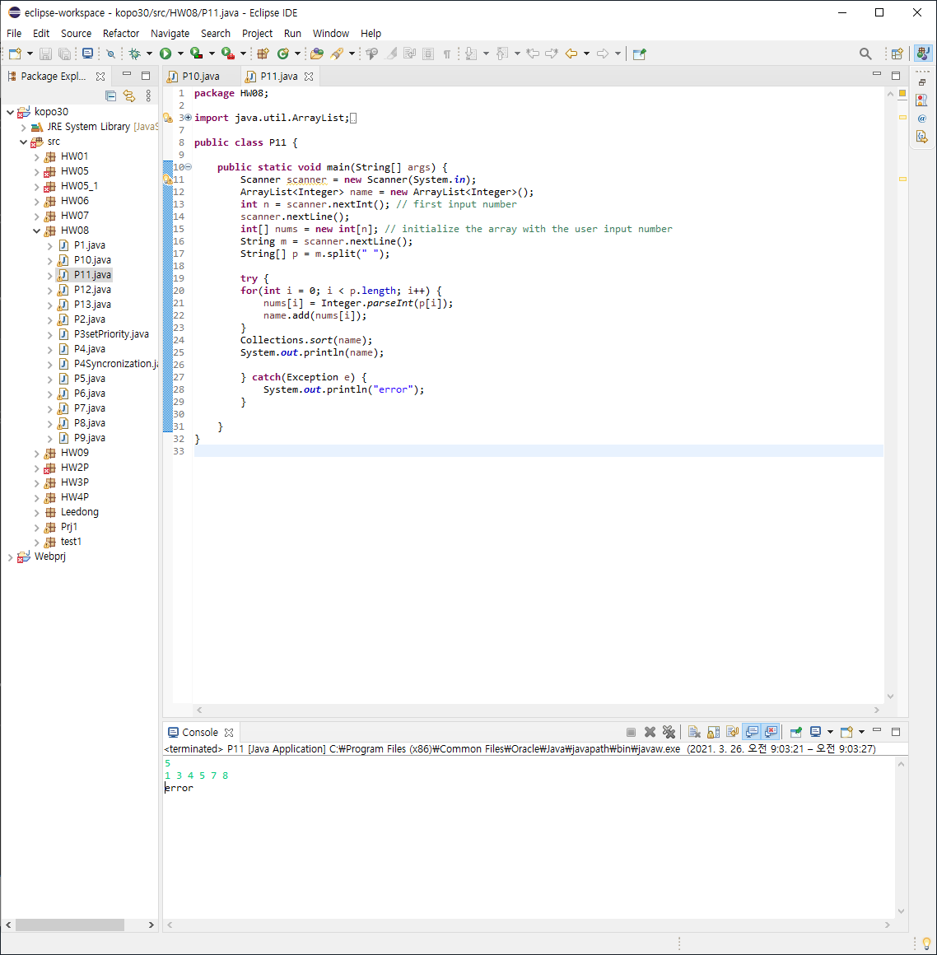
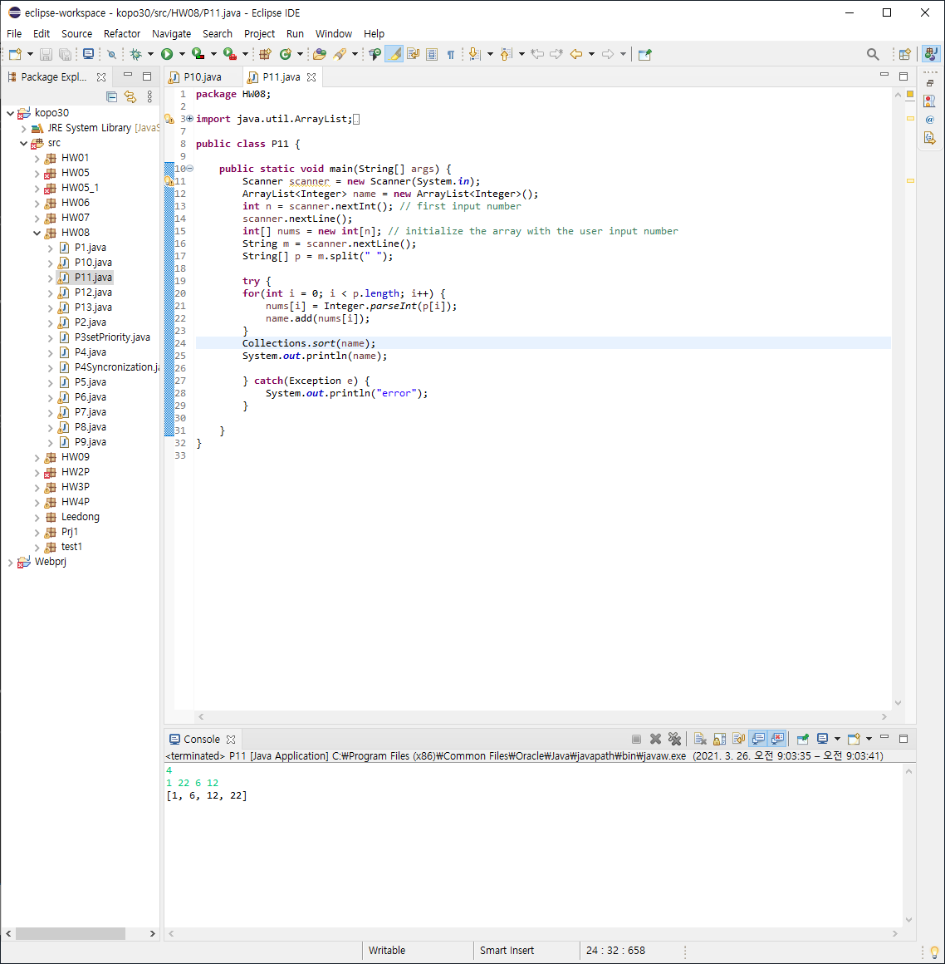
P11 : Exception Handling

Slide 13
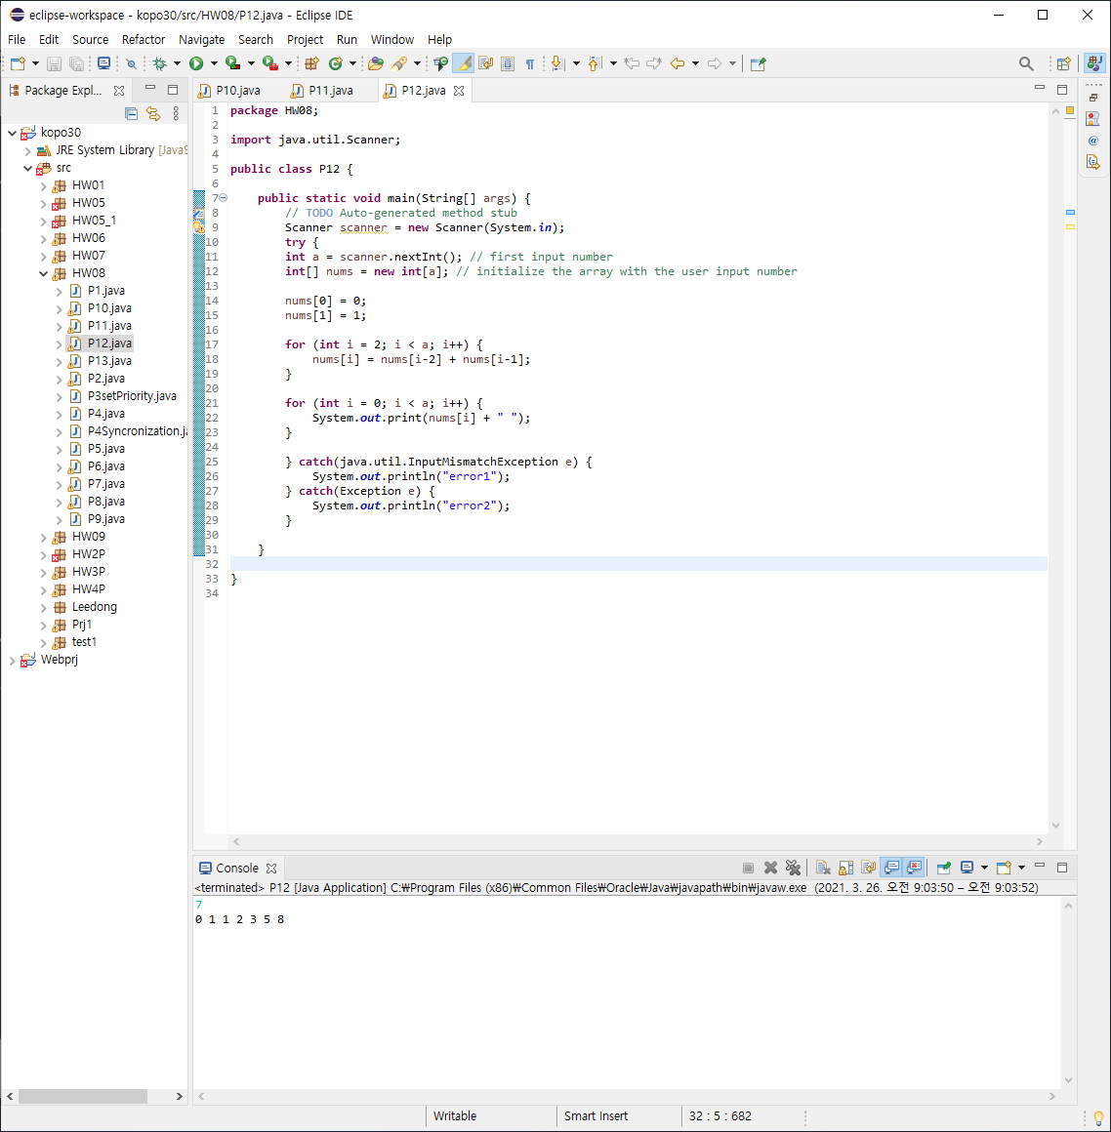
P12 : Fibonacci Numbers

Slide 14
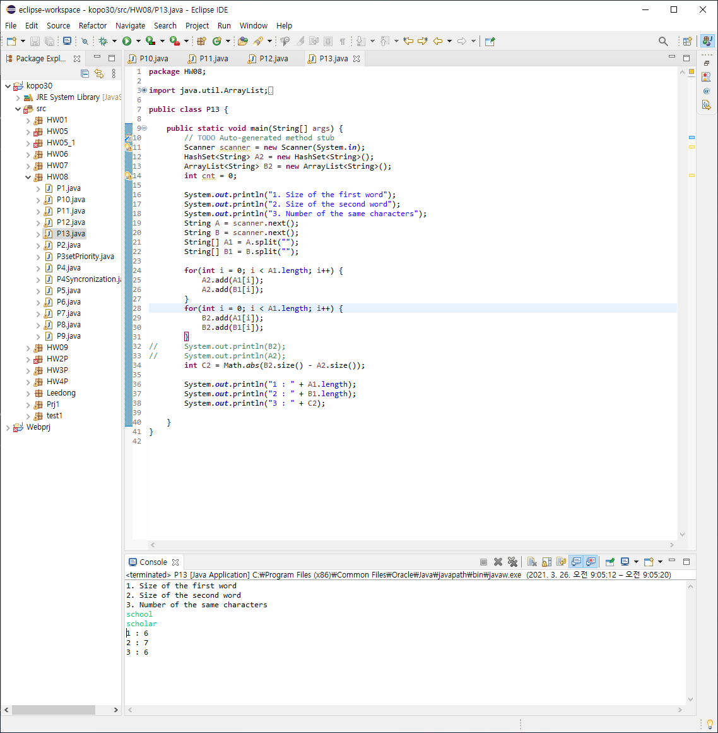
P13 : Comparing Strings

Slide 15
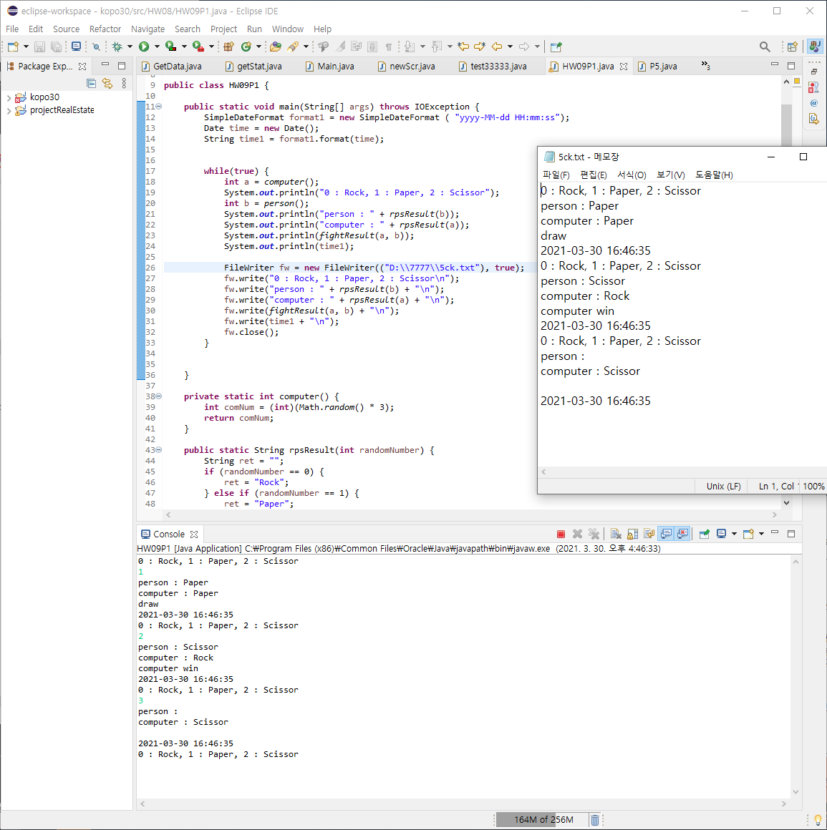
9강 P1 – Database for Rock-Paper-Scissors Game

